Slide 1
Career Agency
Maximizing the affordances to add agency
Presented by: Ziwen
09/16/13
Principles of Interactive Design

Slide 2
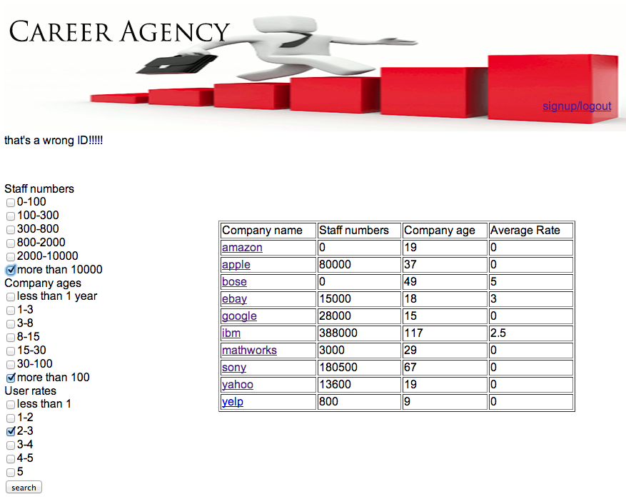

Slide 3
Who needs it?
Those who are determining which company they are going to
Why?
This artifact provides different metadata of companies.
What will they do?
Search by filters, zoom in to individual companies for detailed information.

Slide 4
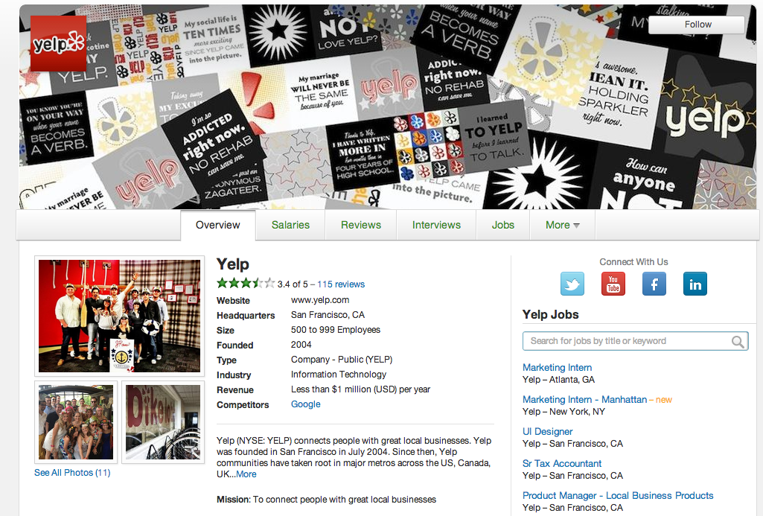
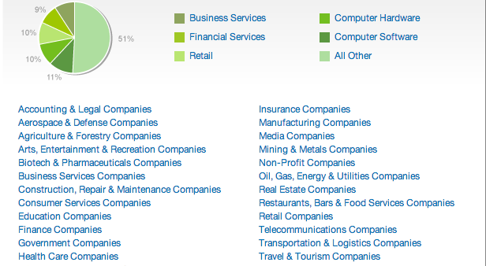
Competitors-No.1 Glassdoor
Emphasis on salaries.
Filtered by company’s main filed
User rating system
Linking with other social media

Slide 5
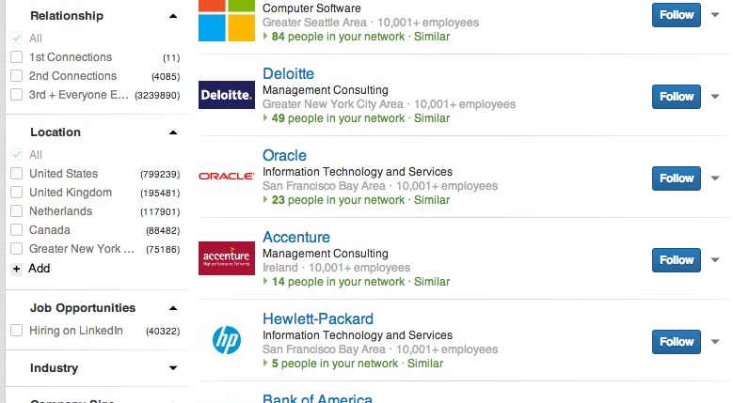
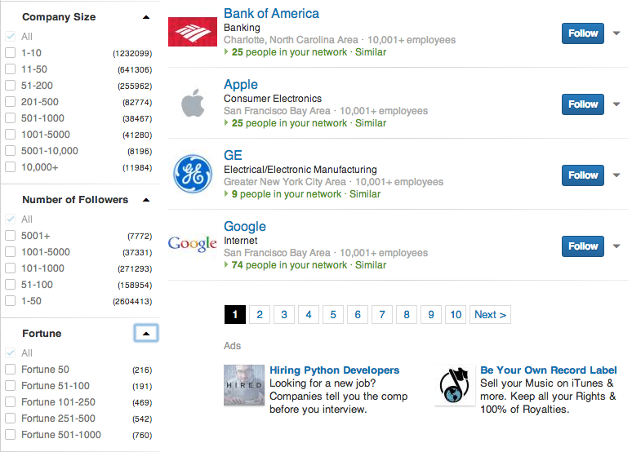
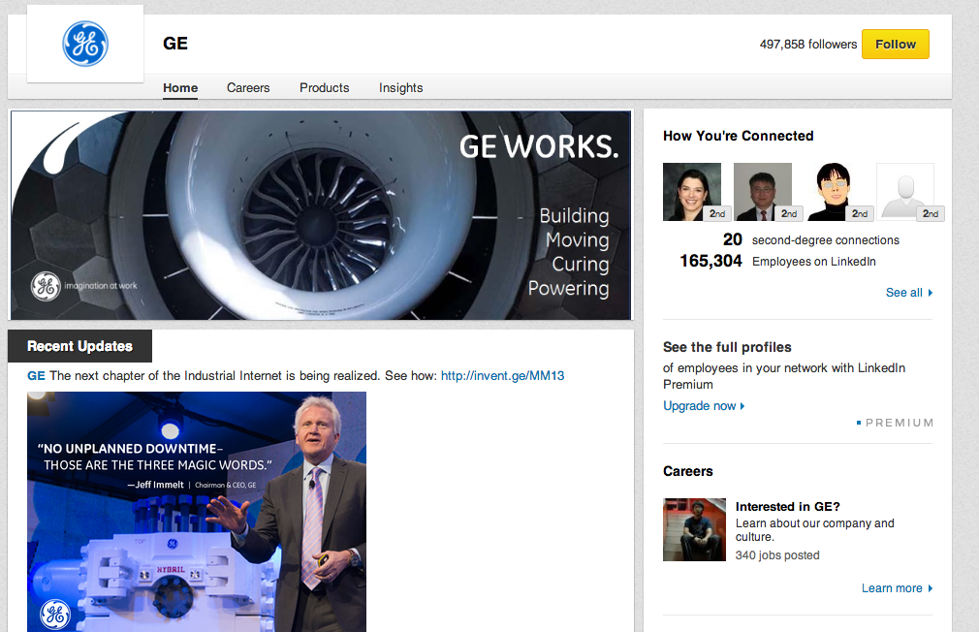
Competitors-No.2 Linkedin
Less metadata
(more user generated)
poor specifications of filters (company size?)

Slide 6
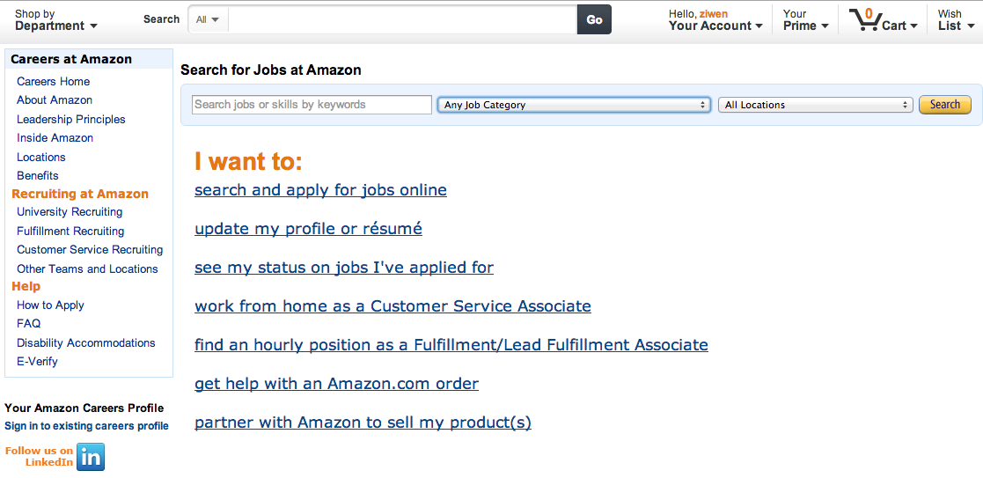
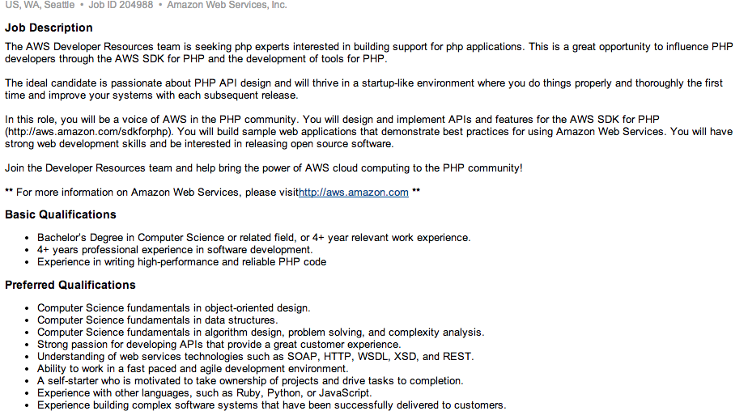
Competitors-No.3 Individual company’s career page
Direct way to apply
for the positions.
Provides poor granularity.

Slide 7
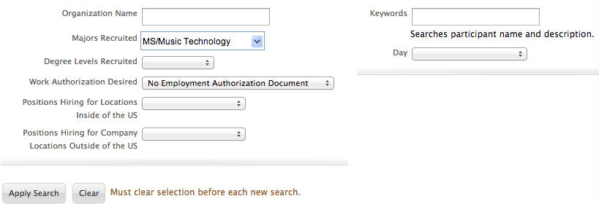
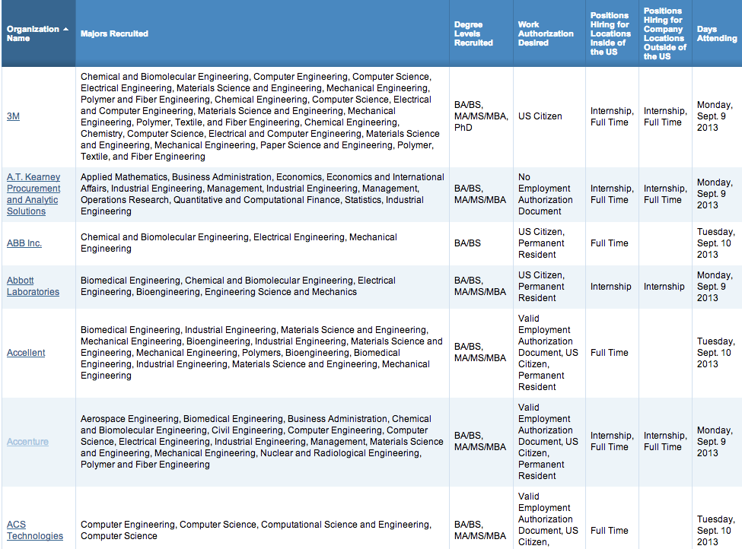
Competitors-last but not least
Fall 2013 Career Fair Participants

Slide 8
 | Procedural | Participatory | Encyclopedic | Spatial
Gatech career fair webpage
Glassdoor
Linkedin
Individual company’s hiring page

Slide 9
 | Procedural | Participatory | Encyclopedic | Spatial
Gatech career fair webpage
Glassdoor
Linkedin
Individual company’s hiring page
Ideal one

Slide 10
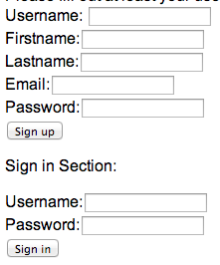
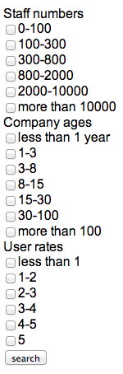
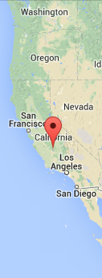

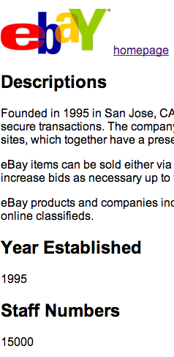
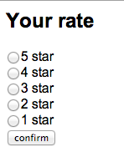
improvements
procedural
encyclopedic
spatial
participatory

Slide 11
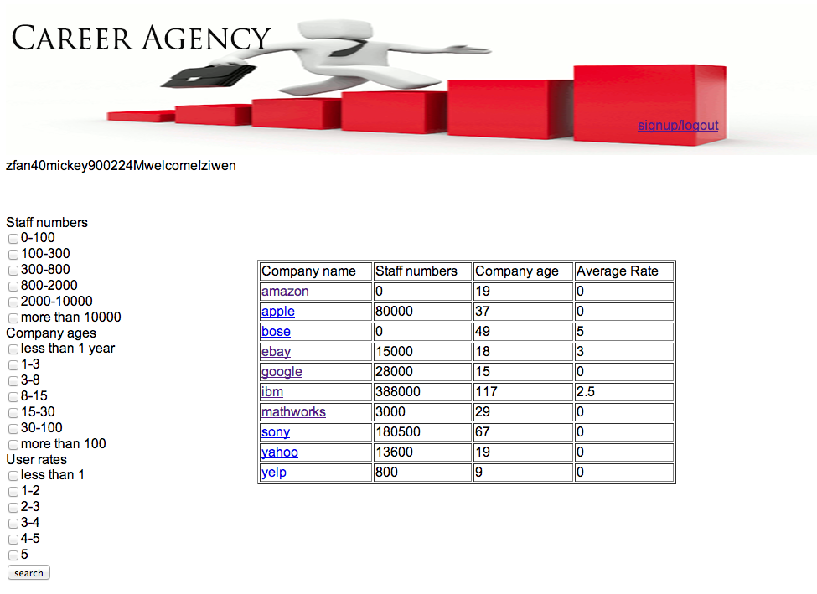
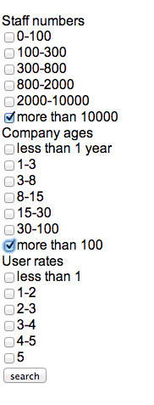
Use case scenario looking for corporations with long history and get detailed information
Overview of all the companies
Faceted search

Slide 12
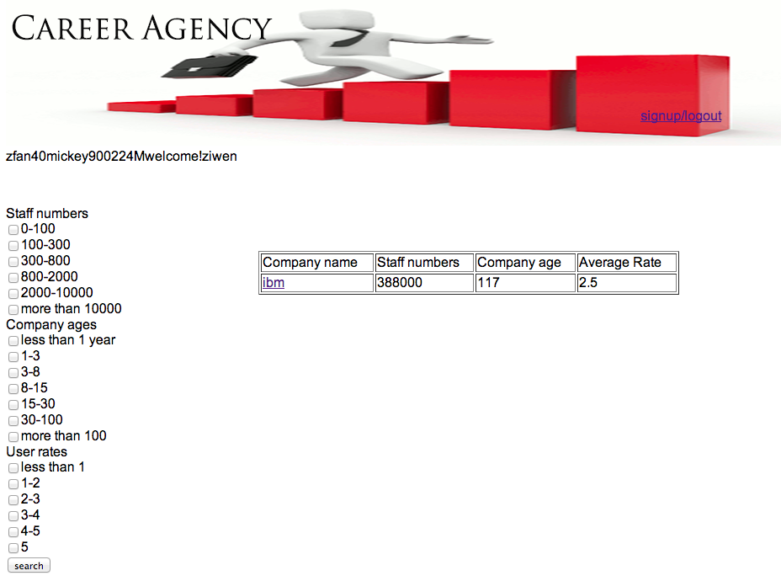
Use case scenario
Returned results
link

Slide 13
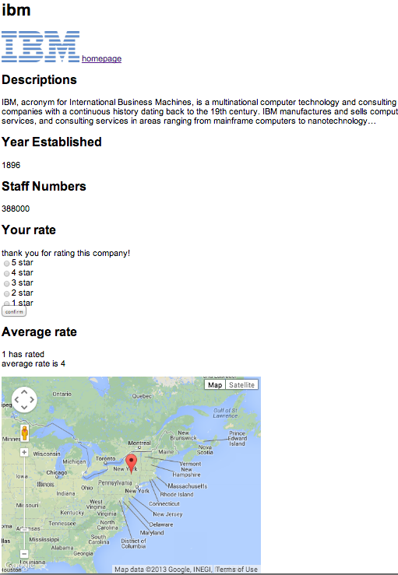
Use case scenario
Company logo
Other metadata
User rates
HQ location map

Slide 14
Future Plans
Spatial
Adding location markers of each office to the map and create a page link to those markers
Encyclopedic
Having more semantic metadata available
More accurate metadata
Having distinctions between employer users and employee/student users
Procedural
Adding more filters, refine the searching algorithms to be more complex
Participatory
Adding a forum for each company
Split the user rate into several categories of rates
SNS style communications

